Slide 1


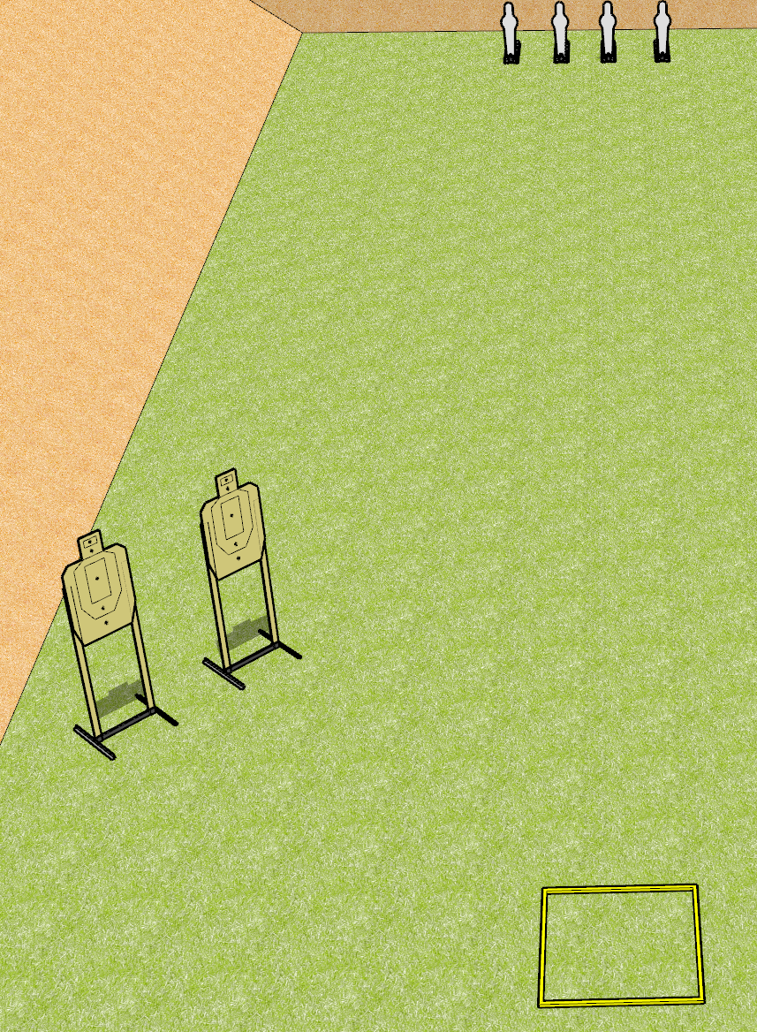
 | Dothan Gun Club – USPSA Match Throttle Control Course Designer : Drew Coleman
Round Count 8 rounds 2 USPSA 4 mini poppers
Equipment List 2 USPSA Shooting box

Slide 2
Throttle Control
Written Stage Briefing
Throttle control is an 8 round, 40 point, Comstock course of fire. There are 2 USPSA targets and 4 mini poppers. The best 2 hits on paper will score, and steel must fall to score. The start signal is audible.
Handgun start position is inside the shooting area, wrists above shoulders. Handgun is loaded and holstered.
PCC start position is inside the shooting area, stock on belt. Loaded carbine is held with both hands, safety on.
On start signal, engage targets as they become available from within the shooting area.

Slide 3
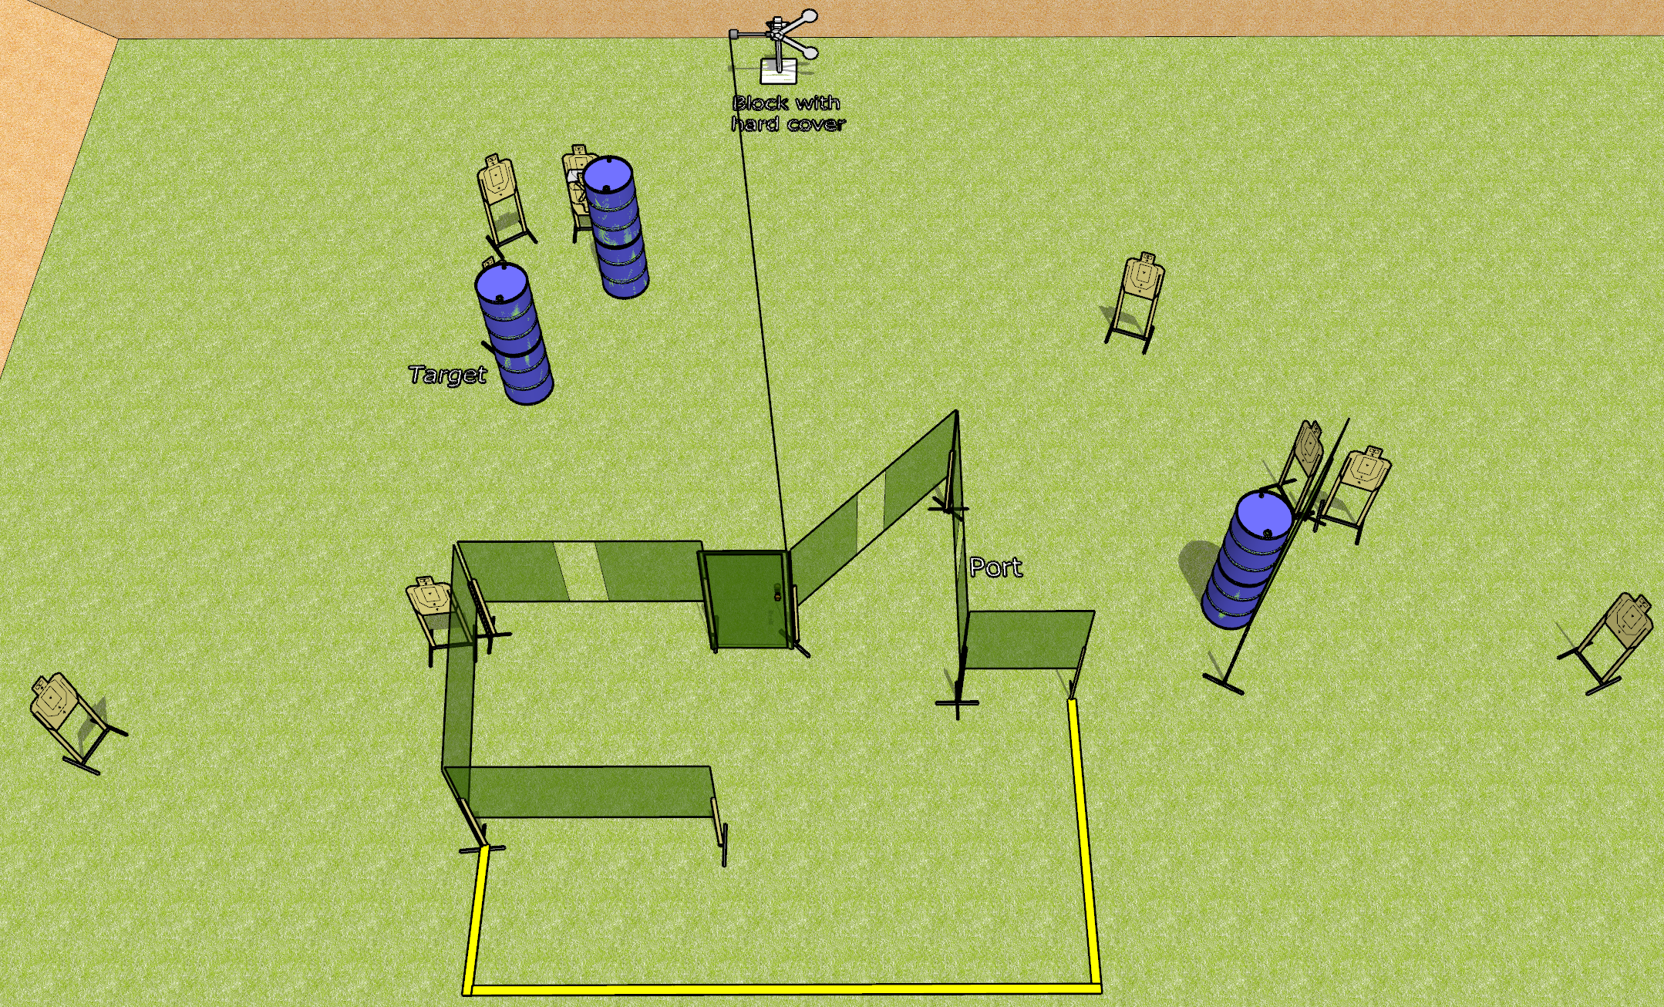
 | Dothan Gun Club – USPSA Match More Open Targets Course Designer : Drew Coleman
Round Count 22 rounds 10 USPSA 2 plates
Equipment List 11 wall feet 1 medium fault line Red stitch swinger + door + activator 11 targets (10 + 1NS)

Slide 4
More Open Targets
Written Stage Briefing
More Open Targets is a 22 round, Comstock course of fire. There are 10 USPSA targets and 2 falling plates. The best 2 hits on paper will score and steel must fall to score. The start signal is audible.
The swinger is activated by opening the door, and must be activated before being engaged.
Handgun start position is anywhere completely outside the shooting area, wrists below belt. Handgun is loaded and holstered.
PCC start position is anywhere completely outside the shooting area, stock on belt. Loaded carbine is held with both hands, safety on.
On start signal, engage targets as they become available from within the shooting area.

Slide 5
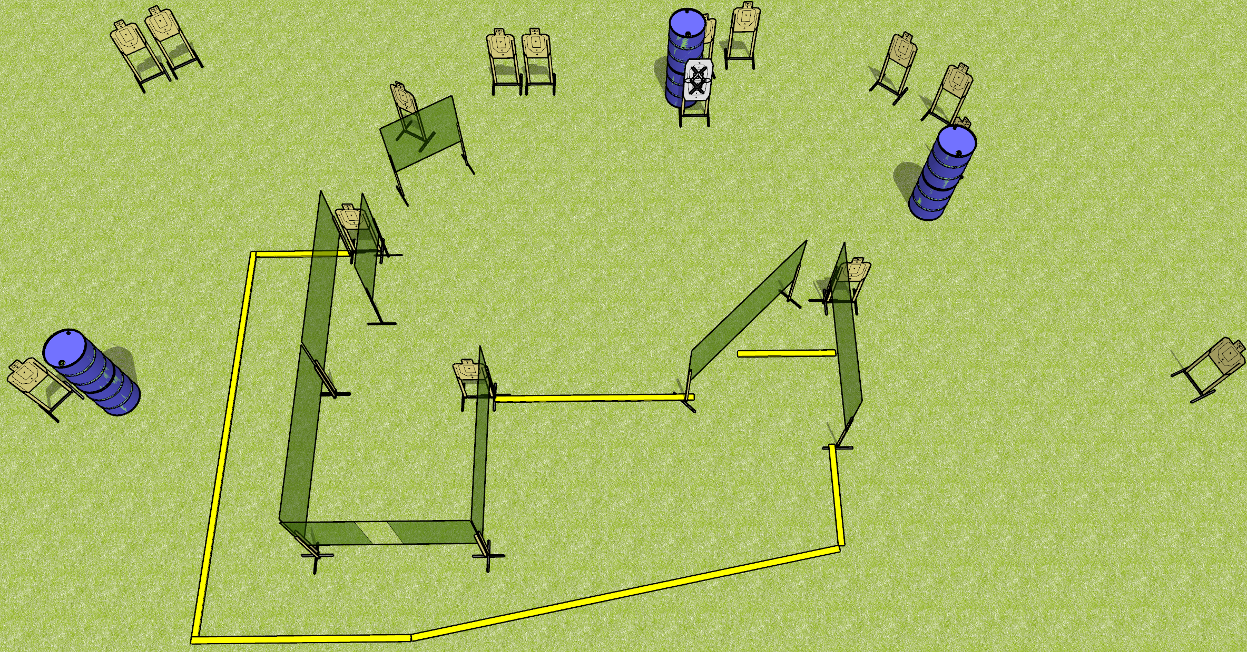
 | Dothan Gun Club – USPSA Match Off Week Course Designer : Drew Coleman
Round Count 30 rounds 15 USPSA
Equipment List 13 wall feet 2 medium fault lines 16 USPSA targets (15 + 1 NS)

Slide 6
Off Week
Written Stage Briefing
Off Week is a 30 round, 150 point, Comstock course of fire. There are 15 USPSA targets. The best 2 hits on paper will score. The start signal is audible.
Handgun start position is inside the shooting area, wrists below belt. Handgun is loaded and holstered.
PCC start position is inside the shooting area, stock on belt. Loaded carbine is held with both hands,
On start signal, engage targets as they become available from within the shooting area.

Slide 7
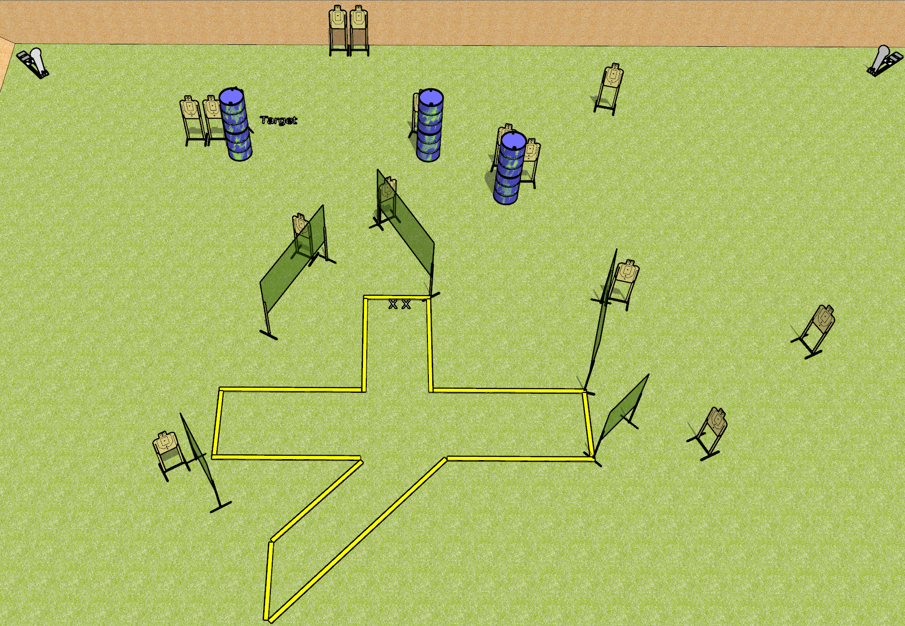
 | Dothan Gun Club – USPSA Match Splat Course Designer : Drew Coleman
Round Count 15 USPSA 2 colt poppers
Equipment List 10 wall feet 4 medium fault lines 15 targets

Slide 8
Splat
Written Stage Briefing
Splat is a 32 round, 160 point, Comstock course of fire. There are 15 USPSA targets and 2 colt poppers. The best 2 hits on paper will score, and steel must fall to score. The start signal is audible.
Handgun start position is toes on X’s, facing downrange, wrists below belt. Handgun is loaded and holstered.
PCC start position is toes on X’s, facing downrange, stock on belt. Loaded carbine is held with both hands, safety on.
On start signal, engage targets as they become available from within the shooting area.

Slide 9
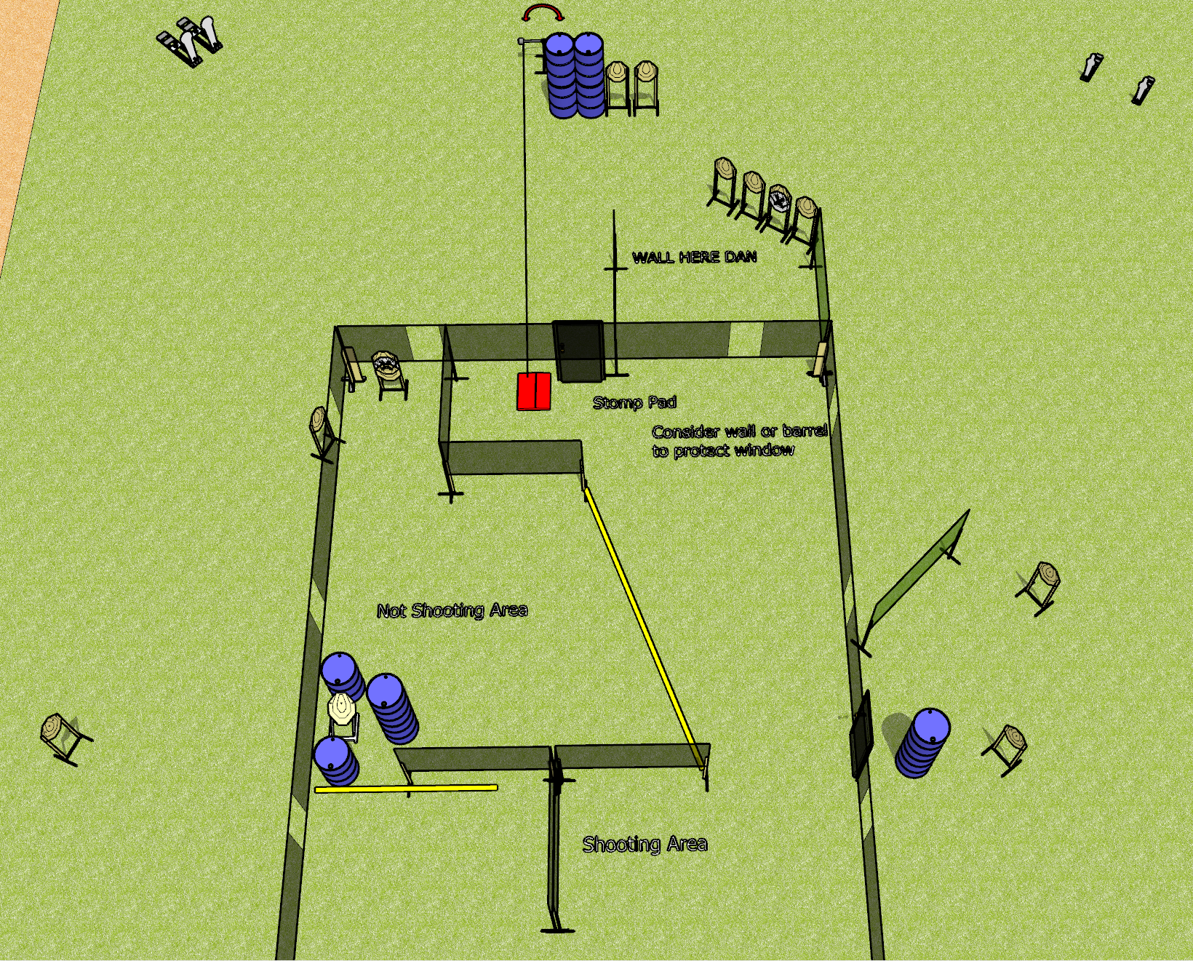
 | Dothan Gun Club – USPSA Match A House Pun Course Designer : Drew Coleman
Round Count 32 rounds 14 IPSC 2 colt poppers, 2 mini poppers
Equipment List 6 wall feet Swinger + stomp box 16 targets (14 + 2NS)

Slide 10
A House Pun
Written Stage Briefing
A House Pun is a 32 round, 160 point, Comstock course of fire. There are 14 IPSC targets, 2 colt poppers, and 2 mini poppers. The best 2 hits on paper will score, and steel must fall to score. The start signal is audible.
The swinger is activated by the stomp box and remains visible at rest.
Handgun start position is inside the shooting area, wrists below belt. Handgun is loaded and holstered.
PCC start position is inside the shooting area, stock on belt. Loaded carbine is held with both hands, safety on.
On start signal, engage targets from as they become available from within the shooting area.
All doors must be closed prior to the start signal.

